Slide 1

Rate X evaluation system
Illuminated Paths, Inspire Growth

Slide 2

students names responsibilities
1- Abdelrahman Mahrous Mohamed
2- Mekhail Amir Lamey
3- Mohamed Mamdouh Mekawi
4- Walid Atef Fayze
5- Mohamed Khalied Refaat
6- Ramy Hany Lamey
7- Rokia Elbadry Mohamed

Slide 3
Introduction
rate X is designed to make assessing student progress easier and more effective for both educators and students. It's user-friendly and flexible, so no matter your teaching style or environment, it seamlessly fits right in.
Our focus is on fairness and transparency. We've made sure that assessment criteria are clear and consistent, so every student gets a fair shot. Plus, timely feedback is built right in to help students grow and succeed.
With our system, you'll have all the tools you need to track student progress and make informed decisions to support their learning journey.
We're excited to have you join us on this new adventure with our Student Evaluation System!

Slide 4

Related idea
Self-Assessment
Portfolio Development
frontiers

Slide 5
Benefits of the Student Evaluation System
1. Reduced wait times for appointments to student
2. Enhanced Feedback: A well-designed evaluation system allows students to provide feedback on courses, instructors, and the overall learning experience.
3. This feedback can lead to improvements in teaching methods, curriculum, and student support services.
4. Quality Assurance: Regular evaluations help maintain educational standards. By assessing teaching effectiveness, course content, and student satisfaction, institutions can ensure consistent quality across programs.

Slide 6
Benefits of the Student Evaluation System
5. Individualized Support: Evaluation data can identify struggling students early on. With this information, educators can offer personalized support, such as tutoring, counseling, or study strategies.
6. Curriculum Enhancement: Evaluation results can guide curriculum development
7. Faculty Development: Constructive feedback from students helps instructors improve their teaching skills

Slide 7
Motivation
The Role of Motivation:
Intrinsic Motivation
Students who are intrinsically motivated tend to engage more
deeply with the learning material and are more likely to respond positively to
evaluations that align with their interests and goals1.
Extrinsic Motivation
External incentives, such as grades or rewards, can motivate
students to perform well in evaluations. However, over-reliance on extrinsic motivators
can undermine intrinsic motivation2

Slide 8
Evaluation problems
students system that are not flexible and also complicated
most of students don't know their real evaluation
Student evaluations can provide valuable insights into the strengths and weaknesses of specific courses, enabling educators to make necessary adjustments to curriculum, assignments, and course materials to better meet student needs and enhance learning outcomes.
Low response rates can undermine the validity and reliability of student evaluations

Slide 9
website solutions
Measuring understanding and achievement
Identify strengths and weaknesses
Improving the educational process
Encouraging interaction and motivation
Providing data to improve education
Preparing students for final exams and practical life

Slide 10
website solutions
Improving the quality of education
Student guidance
Performance Measurement
Providing useful data
Ensuring fairness and objectivity
Strengthening communication between concerned parties

Slide 11
website solutions
Enhancing competitiveness
Motivating students
Evaluating teachers' effectiveness
Enhancing communication between students
Determine proficiency levels and educational standards
educational planning

Slide 12
Overall description
his section will give an overview of the whole system. The system will be explained in its context to show how the system interacts with other systems and introduce the basic functionality of it. It will also describe what type of stakeholders that will use the system and what functionality is available for each type. At last, the constraints and assumptions for the system will be presented

Slide 13
Product Perspective
The product is an educational management system designed to streamline and enhance the interaction between professors, teaching assistants (TAs), academic advisers, and students. The system aims to support academic processes, communication, and resource management within an educational institution.

Slide 14
system user
Professors
Teaching Assistants
Academic Advisers
Students

Slide 15

website features
User Authentication and Authorization
analytics and Reporting
progress Tracking

Slide 16
Tools and Programing languages
Front End | Back End
HTML | PHP
CSS | Angular
Bootstrap
JavaScript
TypeScript
JQuery

Slide 17

Why we used Angular:
Modular Architecture
Two-Way Data Binding
Component-Based Structure
Declarative UI
Strong Typing with TypeScript
Comprehensive Tooling
Performance Optimization

Slide 18

Why we used PHP:
Ease of Use
Server-Side Scripting
Database Integration
Extensive Frameworks and Libraries
Cost-Effective
Large Community and Support

Slide 19
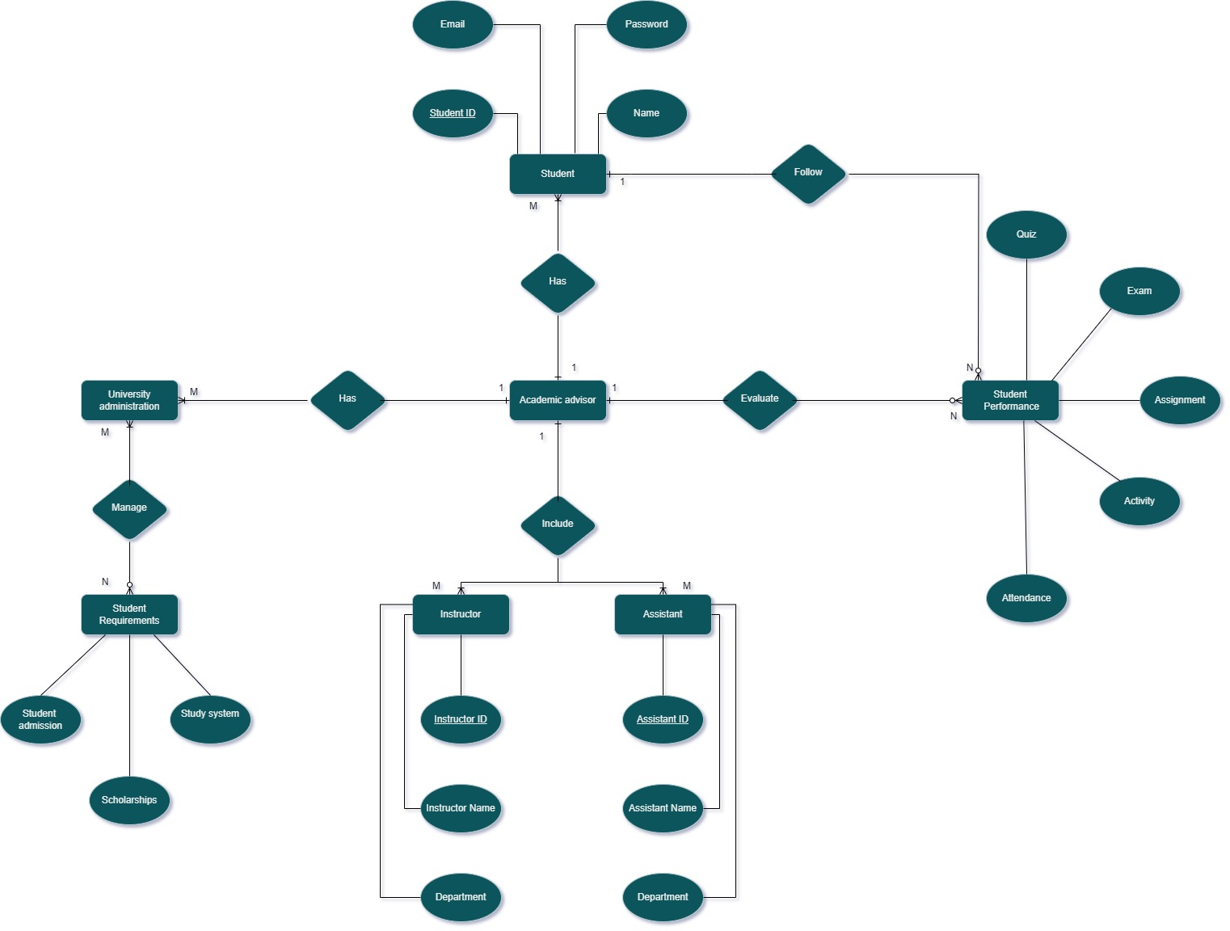
ERD

Slide 20
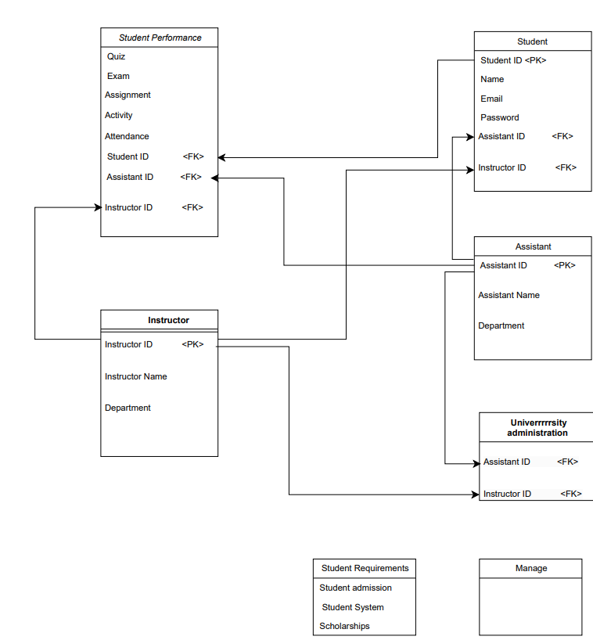
schema

Slide 21
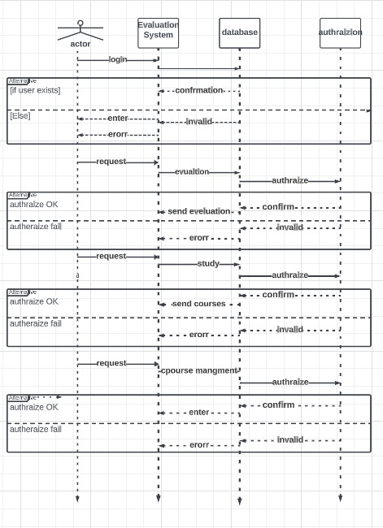
sequence diagram

Slide 22
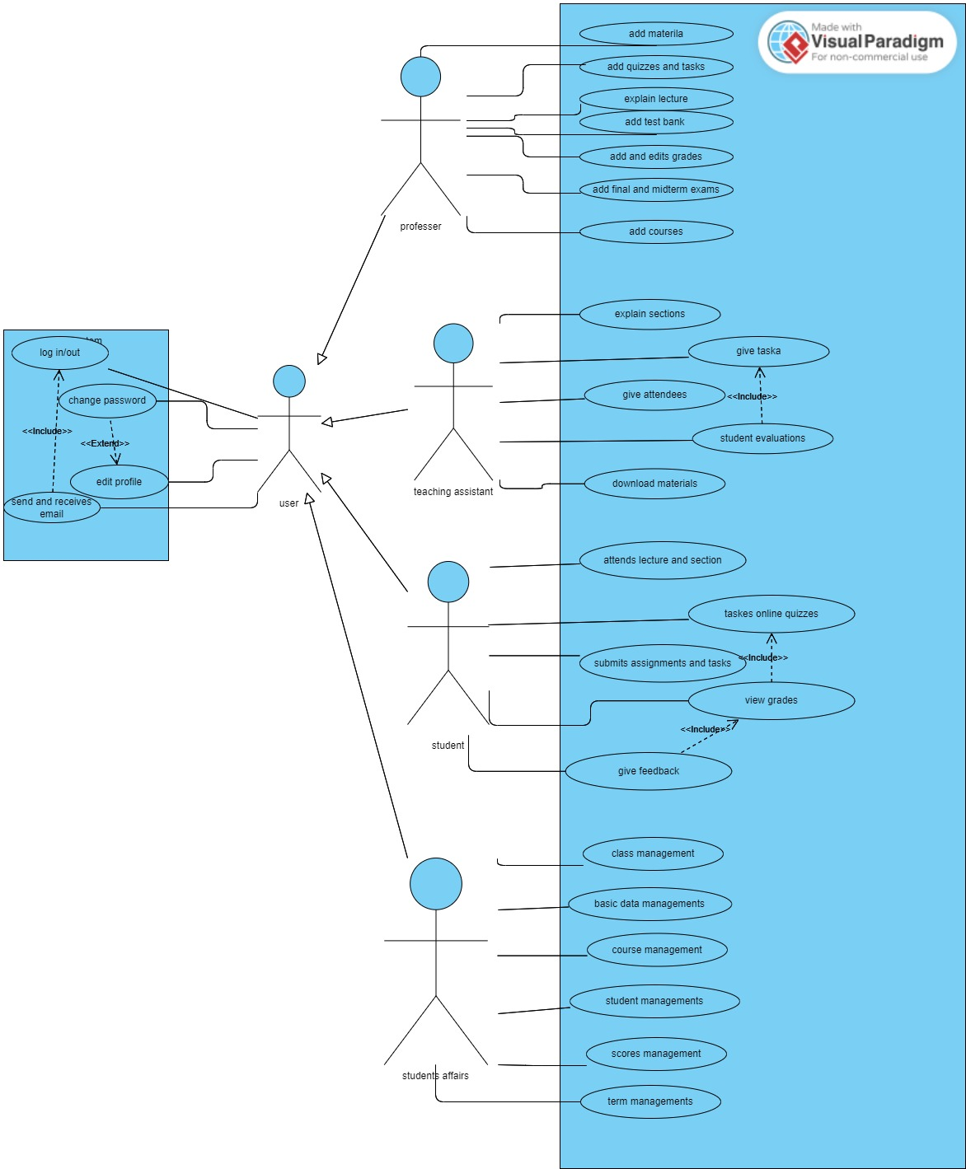
use case

Slide 23
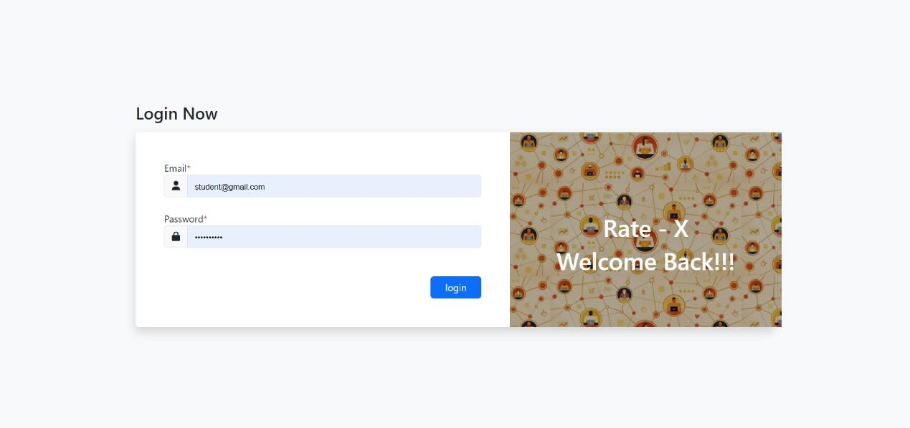
Login Page

Slide 24
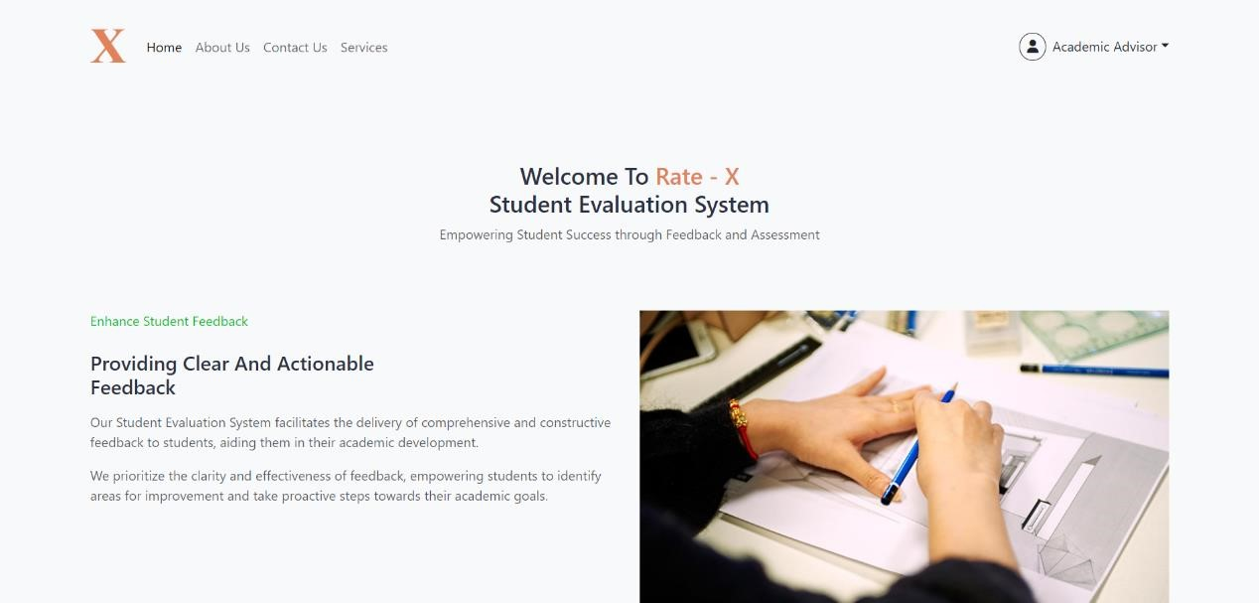
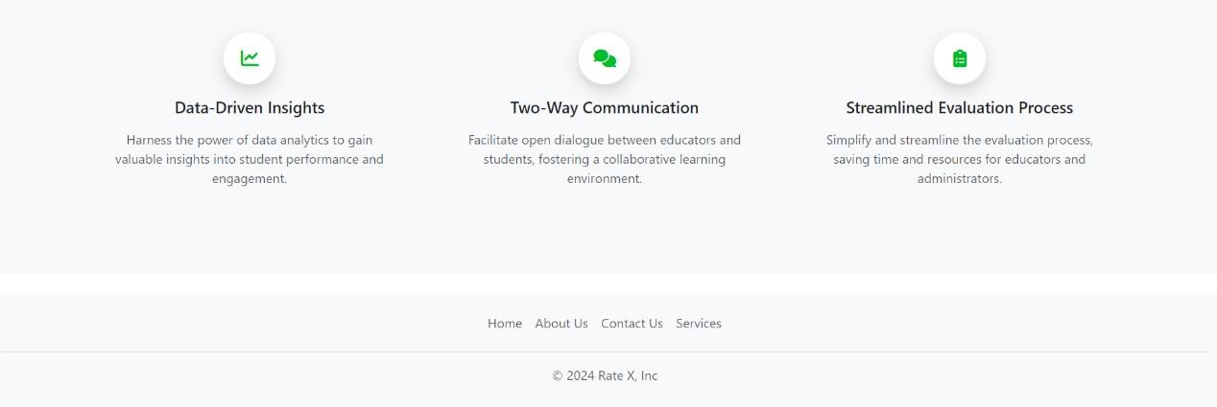
Academic Advisor

Slide 25
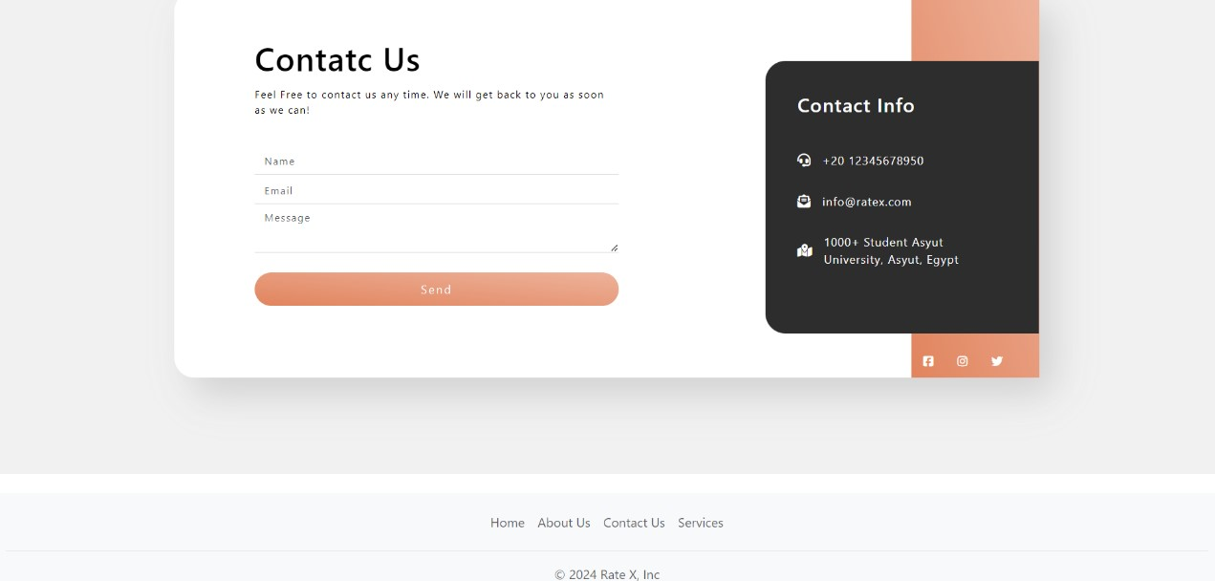
Contactc-US Page

Slide 26

Doctor Page

Slide 27
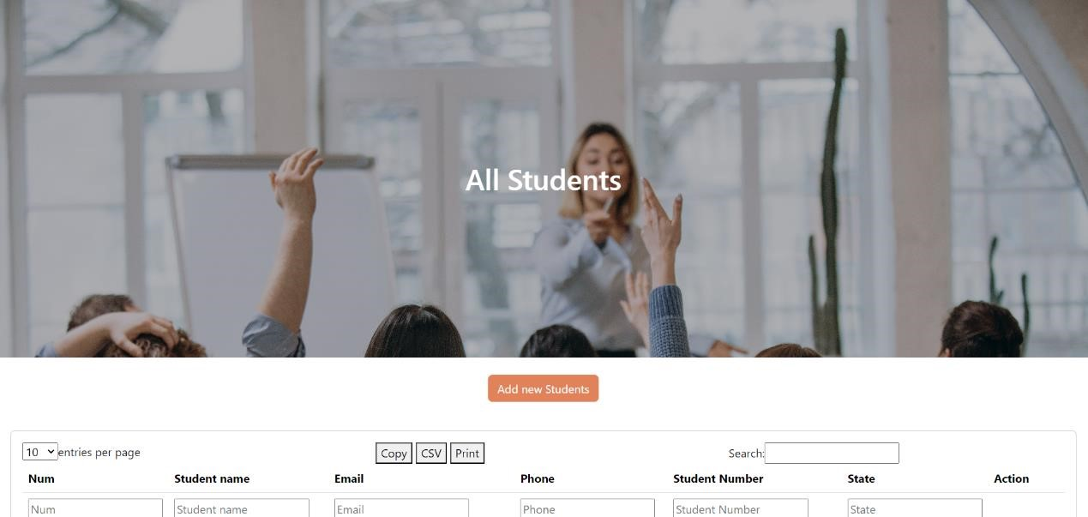
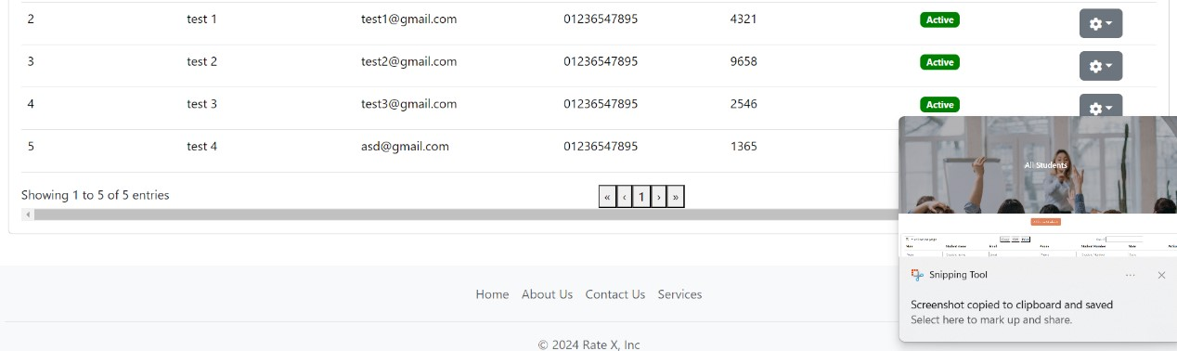
All Student Page

Slide 28
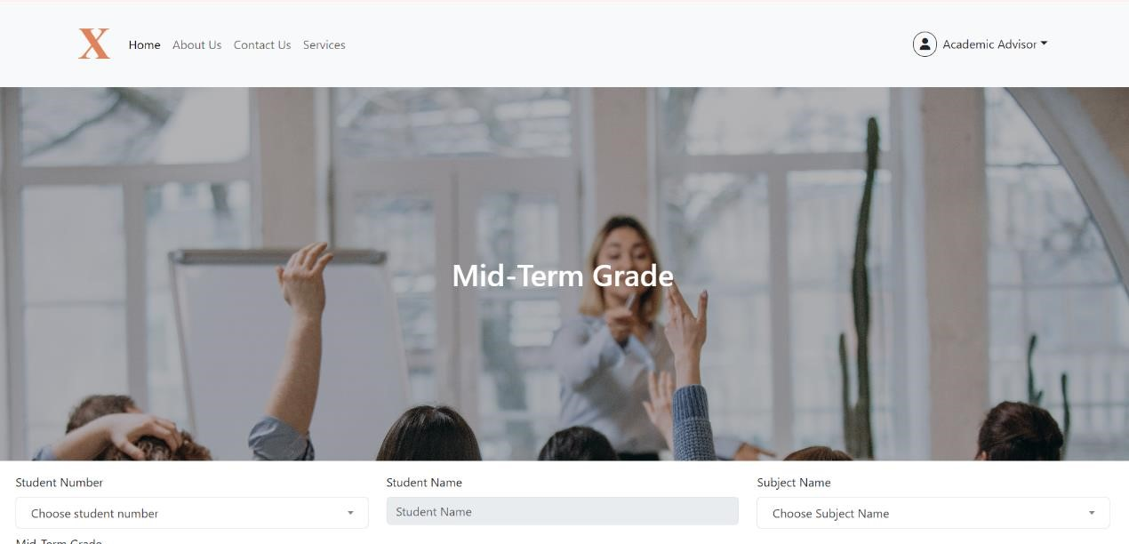
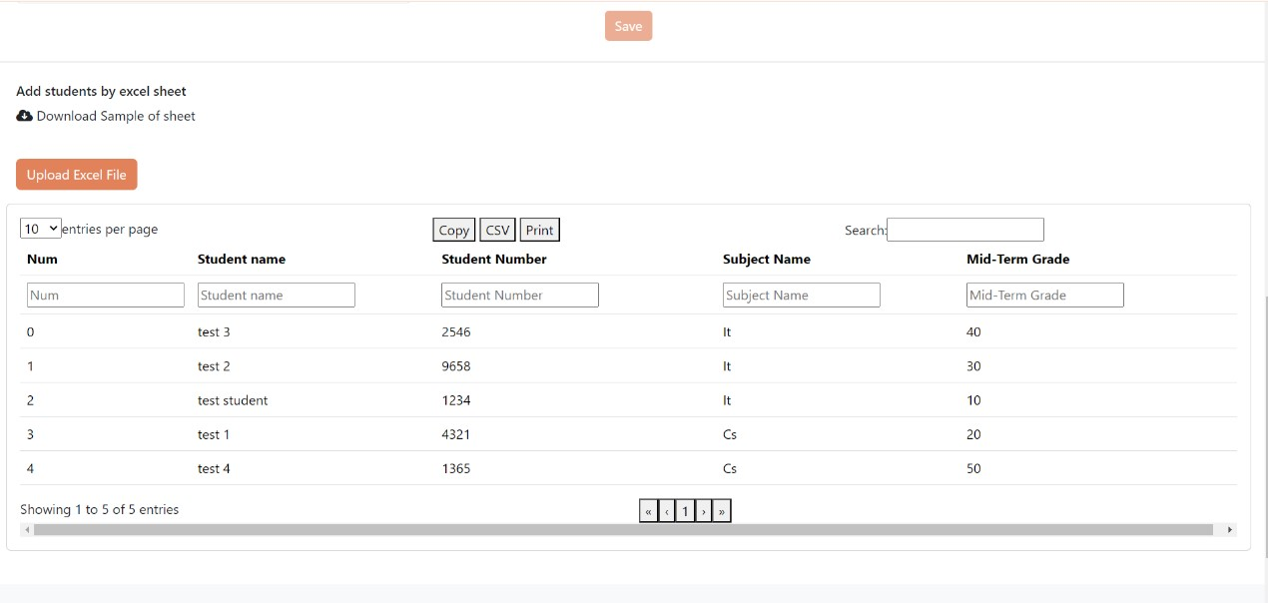
Mid-Term Grade Page

Slide 29
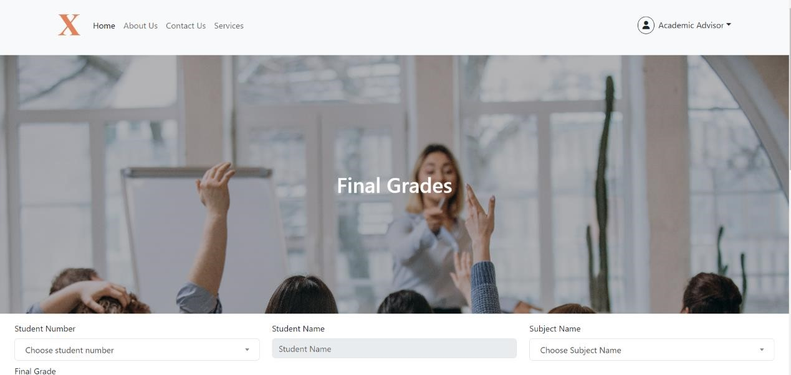
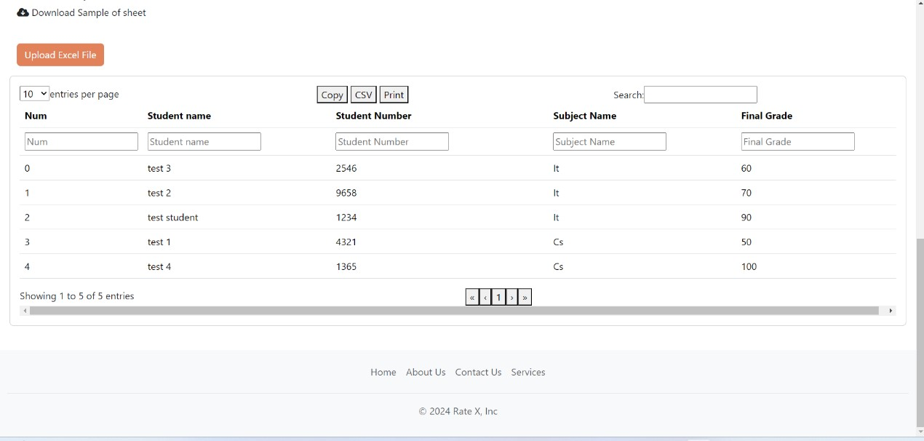
Final Grade Page

Slide 30

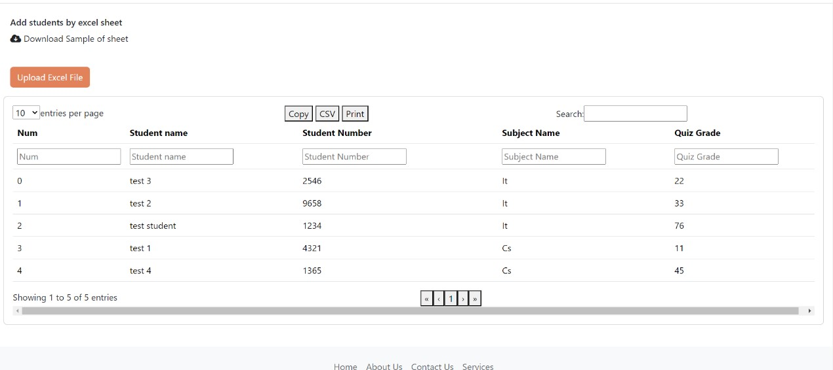
Quizzes Page

Slide 31
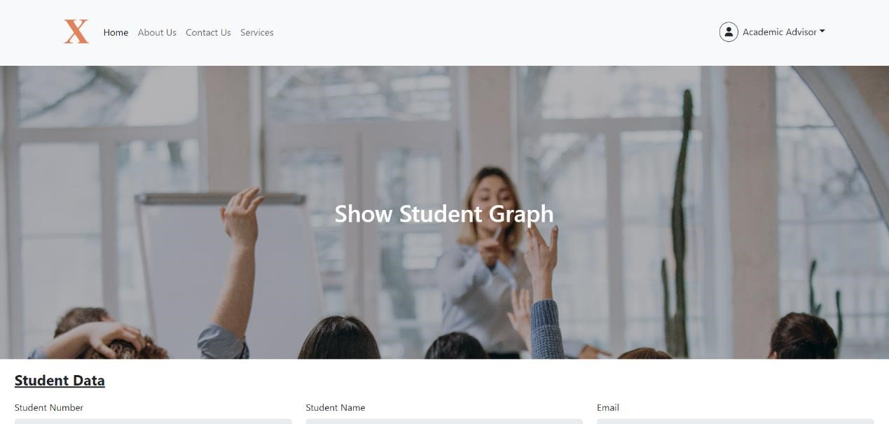
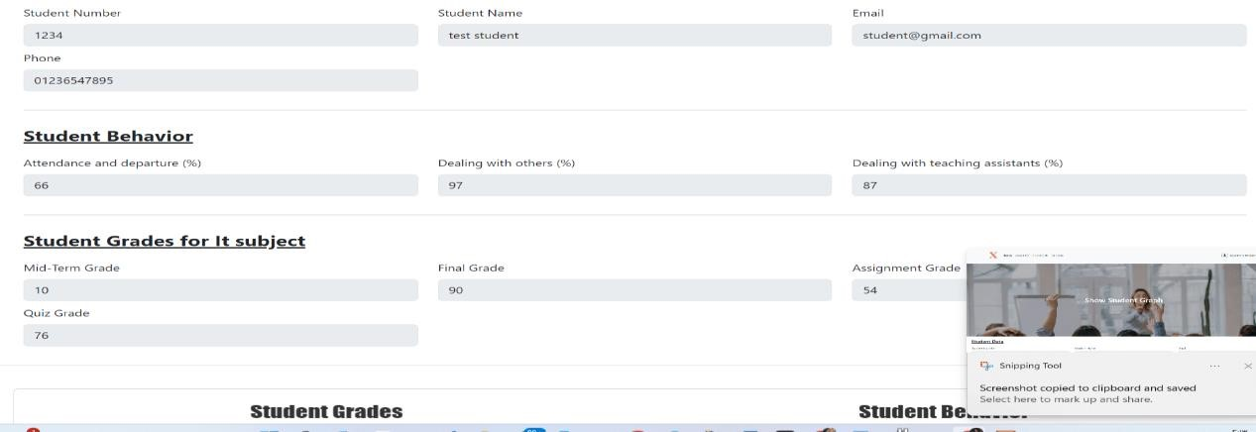
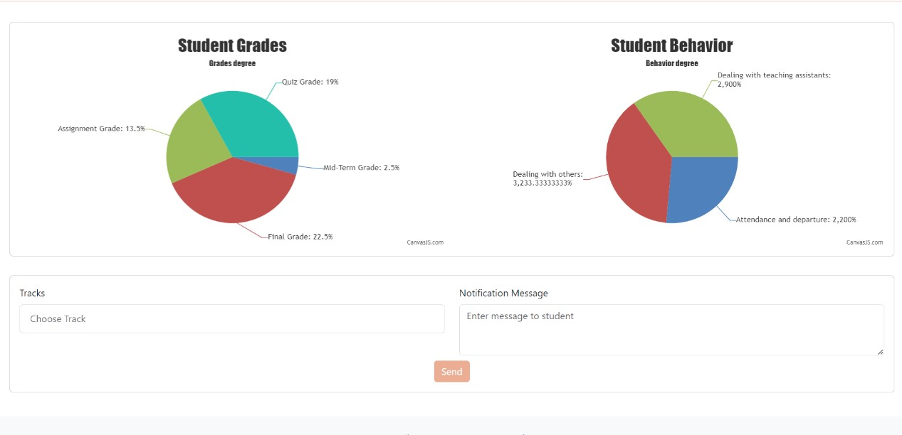
Student Graph Page

Slide 32
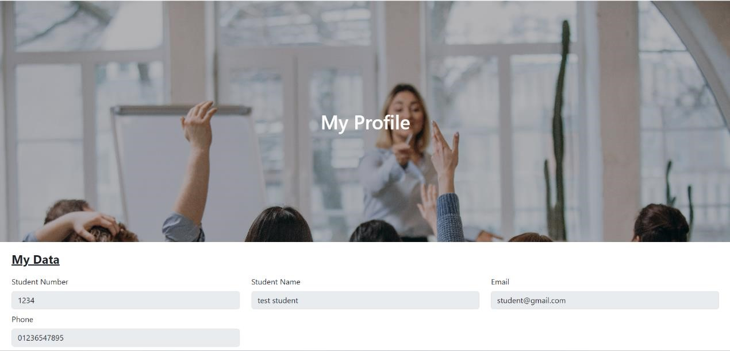
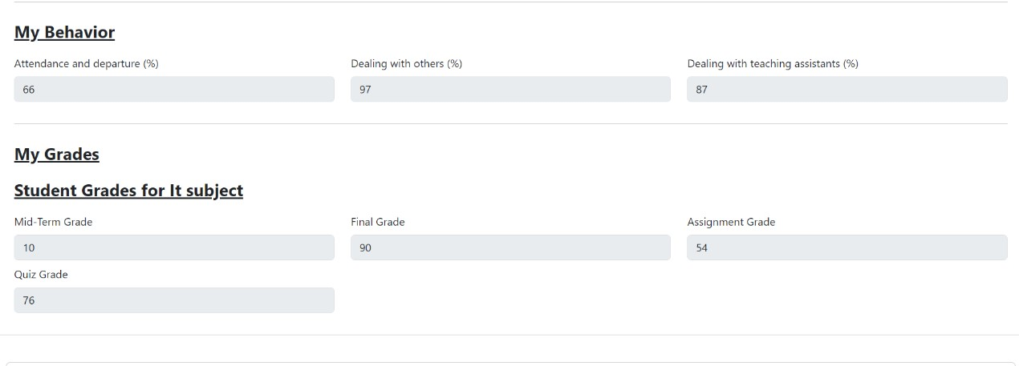
My Data Page

Slide 33
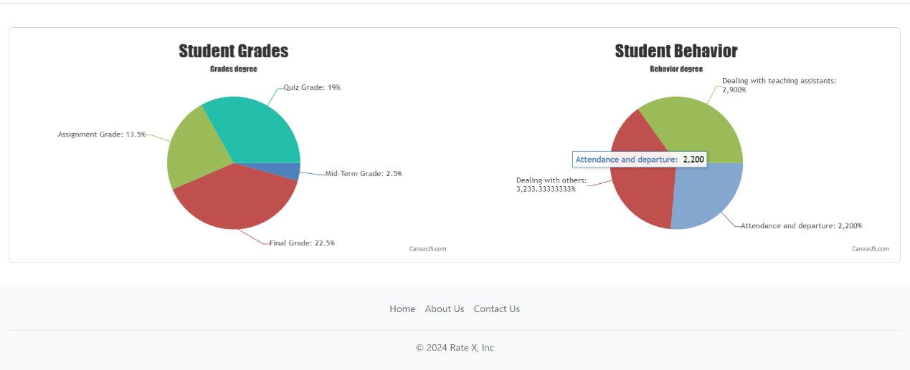
Student evaluation graph

Slide 34
Thank you
The end

